Slide 1
AI Advanced
Virtual Painter🖌
-20RH1A1213(B.SAMYUKTHA)
-20RH1A1224(B.AISHWARYA)
-20RH1A1237(CH.HIMA BINDHU)
-20RH1A1247(D.SNEHA)

Slide 2
ABSTRACT
Air canvas is a hands-free digital drawing canvas.
It utilizes a Camera and OpenCV to recognize and map hand gestures onto screen.
The idea for Air Canvas was a result of our interest in digital drawing and smart photo recognition software.
Here gesture Detection and tracking are used in order to achieve the objective.

Slide 3
INTRODUCTION
Air canvas allows you to sketch on a screen by simply waving your finger across it fitted with a brightly coloured point or a plain coloured cap.
We'll make use of OpenCV computer vision algorithms were used to create this project.
The Python is my preferred language because of its extensive libraries and ease of use syntax.

Slide 4
PROBLEM STATEMENT
The existing system works with color detection at fingertip. It is based on,
-Color Tracking of Object at fingertip.
-Drawing the Line using the position of Contour.
-Problems in existing method are, color detection of tip of finger and same color if it is in background or user dress. It causes problem in point drawings.
-It also not gives accurate drawing output. We have to set a color to detect, hence you should know color coding.

Slide 5
TO OVERCOME THE ISSUE
In order to reduce the complexity of code we here use python language and some libraries like OpenCV,numpy and handwriting module.
By using some inbuilt functions of the imported libraries we detect and extract text from images.
These are specially executed using laptop with a cam and windows.

Slide 6
REQUIREMENTS
Python 3
Numpy
OpenCV

Slide 7
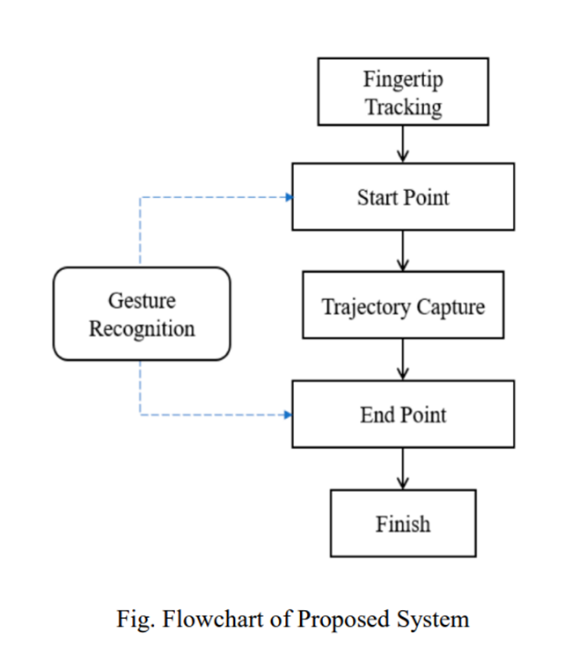
Flowchart

Slide 8
ALGORITHM
Start reading the frames and convert the captured frames by detecting hand gestures.
Prepare the canvas frame and put the respective ink buttons on it and shaped like circle rectangle.
Add hand detector module in handwriting module imported library.
Detect the contours, find the center coordinates of largest contour and keep storing them in the array for successive frames .(Arrays for drawing points on canvas)
Finally draw the points stored in array on the frames and canvas .

Slide 9
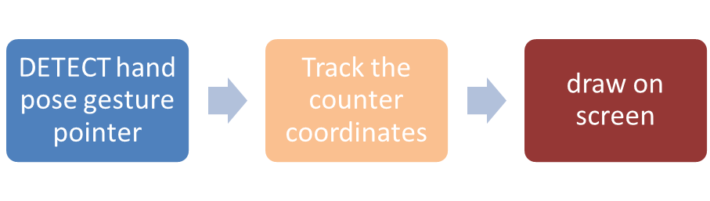

Slide 10
Features
1 : Variable Eraser thickness
2 : Drawing circle
3 : Drawing rectangle
4 : Drawing ellipse
5 : Free Hand Writing
6 : Two fingers up, clears the complete screen
7 : Showing brush thickness on screen

Slide 11
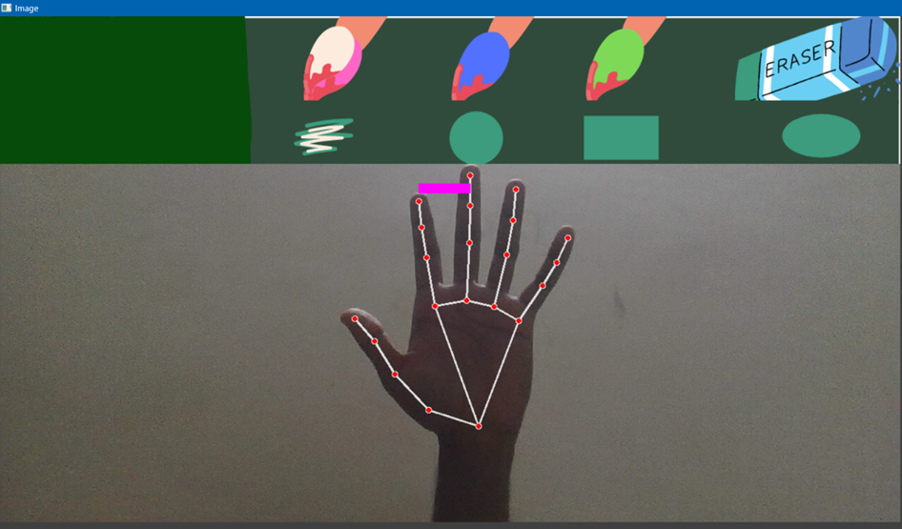
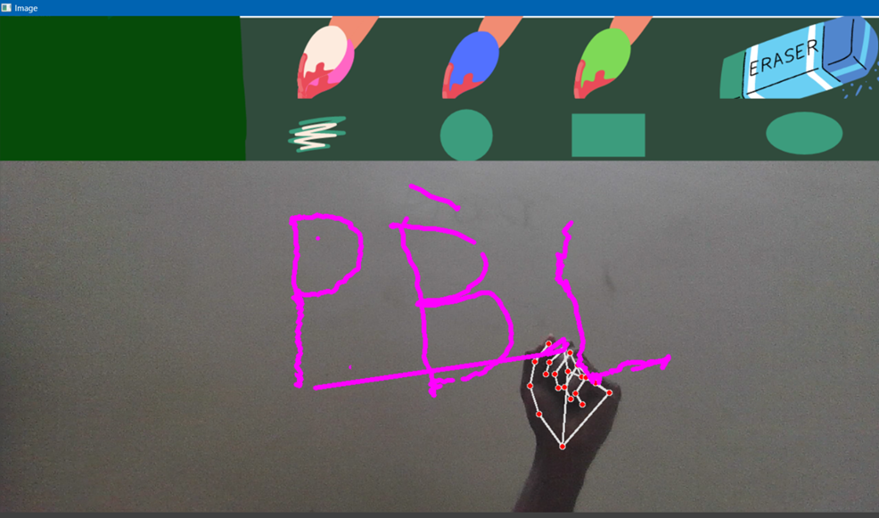

Slide 12
Advantages
The most exciting part of this system is the workflow phase. Writing involves a lot of functionalities. So, the number of gestures used for controlling this particular system is equal to these number of actions involved. The basic functionalities that are included in this system are
1. Writing Mode - In this state, the system will trace the fingertip coordinates and stores them.
2. Colour Mode – The user can change the color of the text among the various available colors.
3. Backspace - Say if the user goes wrong, we need a gesture to add a quick backspace

Slide 13
CONCLUSION
Finally, I would like to conclude that the simplest method for air canvas. By using Python 3,numpy and OpenCV ,we can construct a pretty good project. It is very useful in online classes for explanation . Paper wastage is not scarce news. We waste a lot of paper in scribbling, writing, drawing, etc.…this application allows the user to save their final work or watch their drawing process as a playback animation could also be unique feature that resemble real creativity software.

Slide 14
Thank you

